Slide 1
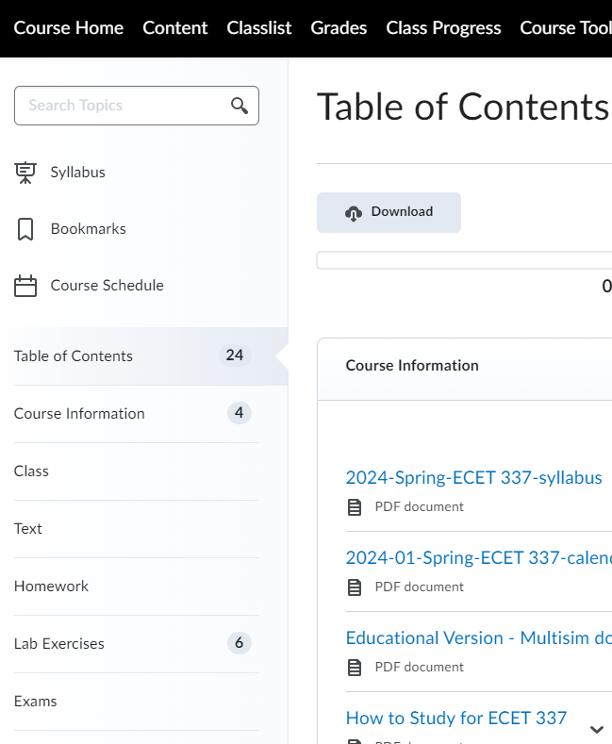
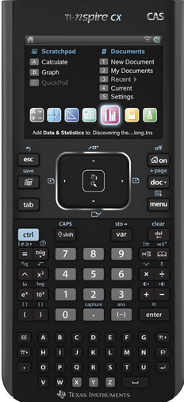
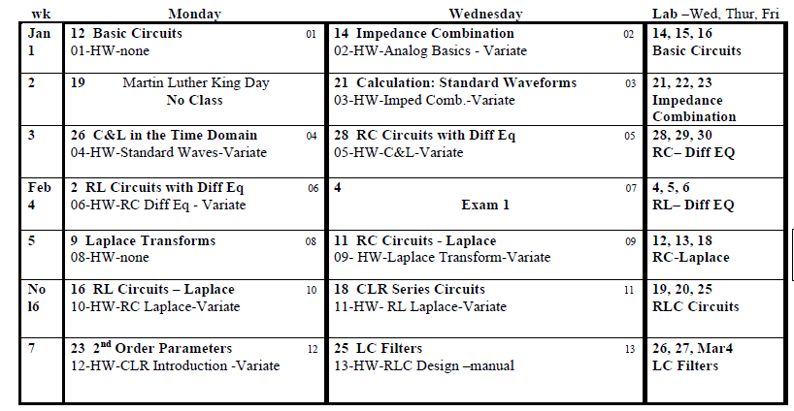
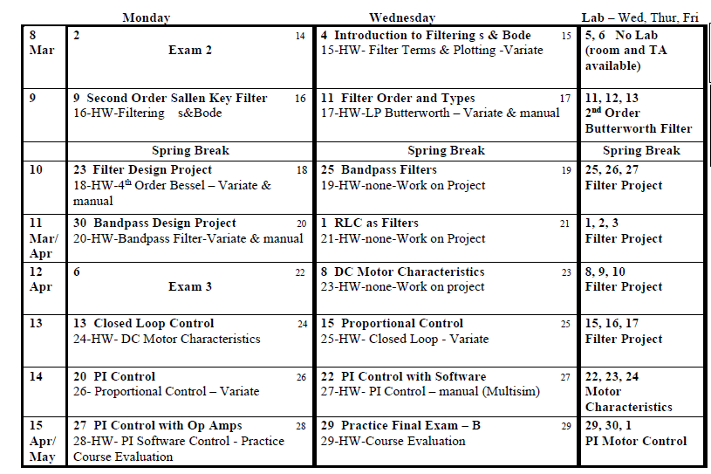
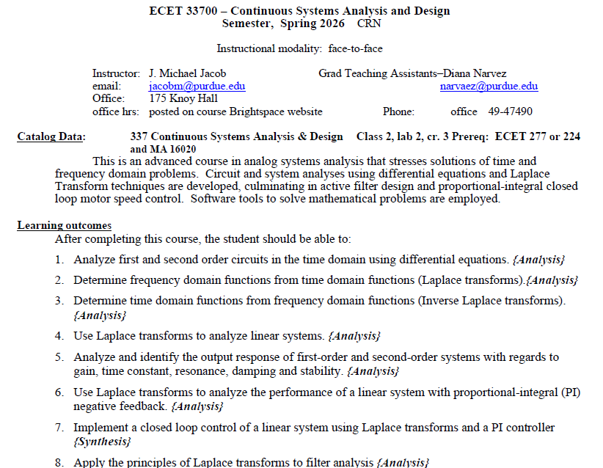
ECET 337 Continuous Systems and Design

Slide 2
Calendar

Slide 3
Lab
Prelab: (at beginning of lab) 10%
Performance: 60%
Be sure these are credited before you leave.
Full credit by end of your lab period.
Half credit before next week’s lab.
Get started on next week’s lab.
MLK day shifts
Report: 30%
3 consecutive A or B (24-30) => exempt

Slide 4
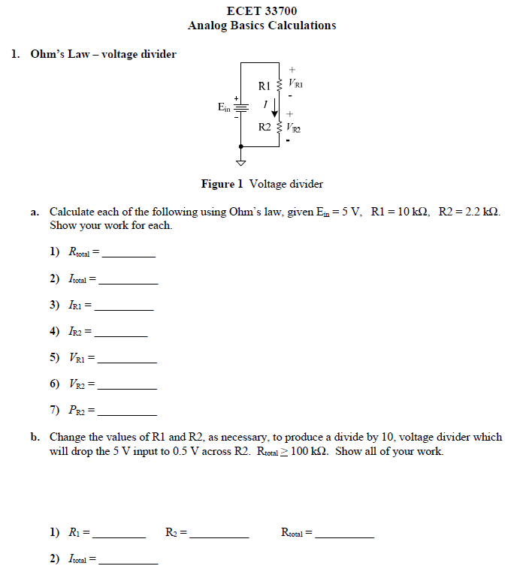

Slide 5
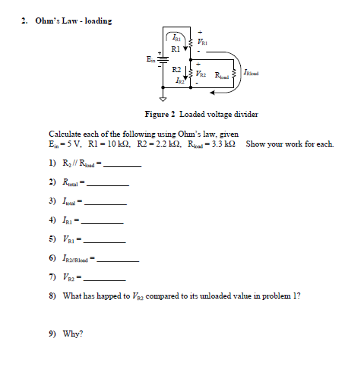

Slide 6
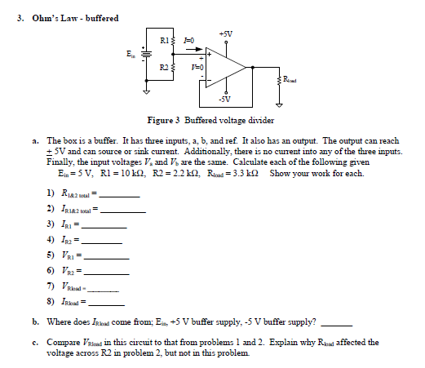

Slide 7
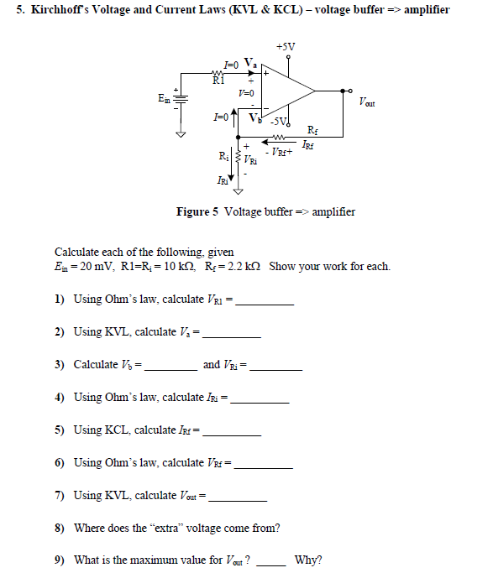

Slide 8
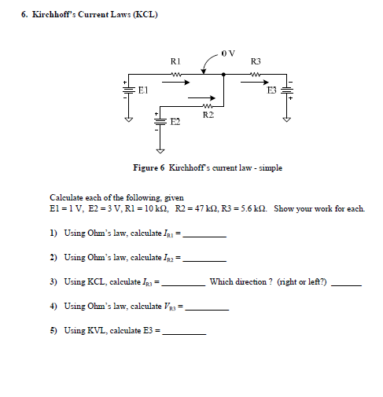

Slide 9
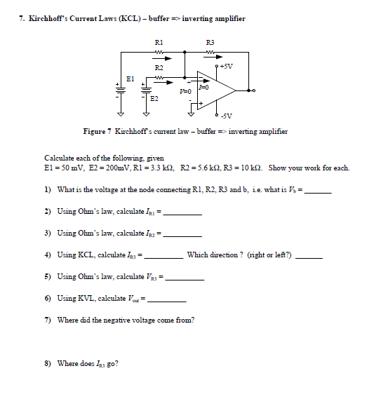

Slide 10
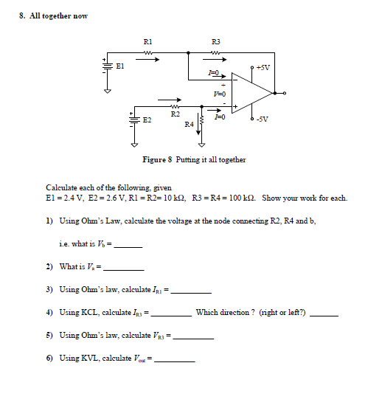

Slide 11
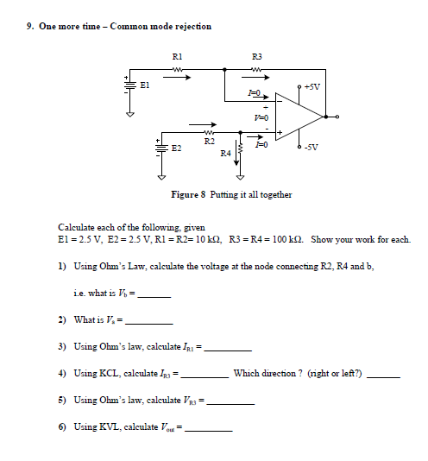

Slide 12
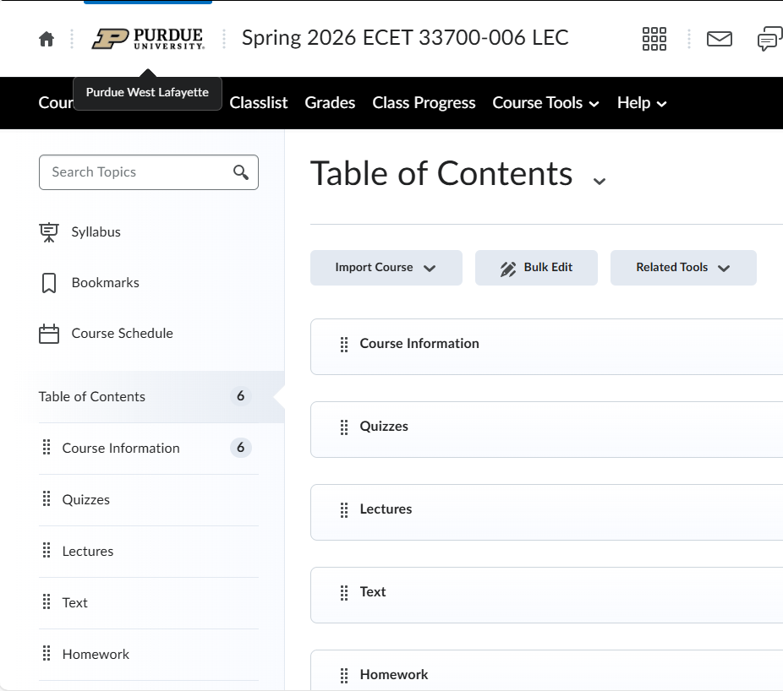
Variate!! NOT manual.
Link from Brightspace
not Variate
Practice => Recorded
Units REQUIRED
Engineering notation
preferred

